Slide 1
Identifying Locations for Grain Formation In Core Collapse Supernova Outflows
Els Shepard
Mentor: Dr. Maitrayee Bose
ASU School of Earth and Space Exploration
18 April 2026

Slide 2
Journey of a stardust grain
Meteorites
Expelled from progenitor, grains travel through the
deliver embedded stardust grains to Earth!
Atoms were fused in the interior of the
interstellar medium.
progenitor star.
Outflow event
Grains were incorporated into rocky material in
(ex: supernova) occurred, where individual grains condensed.
our solar system.
Notes:
Also say:
Grains get their chemical isotope signatures/ratios in the outflow event
The grains we observe are well preserved from outflow to present – rare! Low abundance!
We can identify part of a meteorite as a stardust grain by seeing if its oxygen isotopic signatures are very different from material in our solar system.

Slide 3
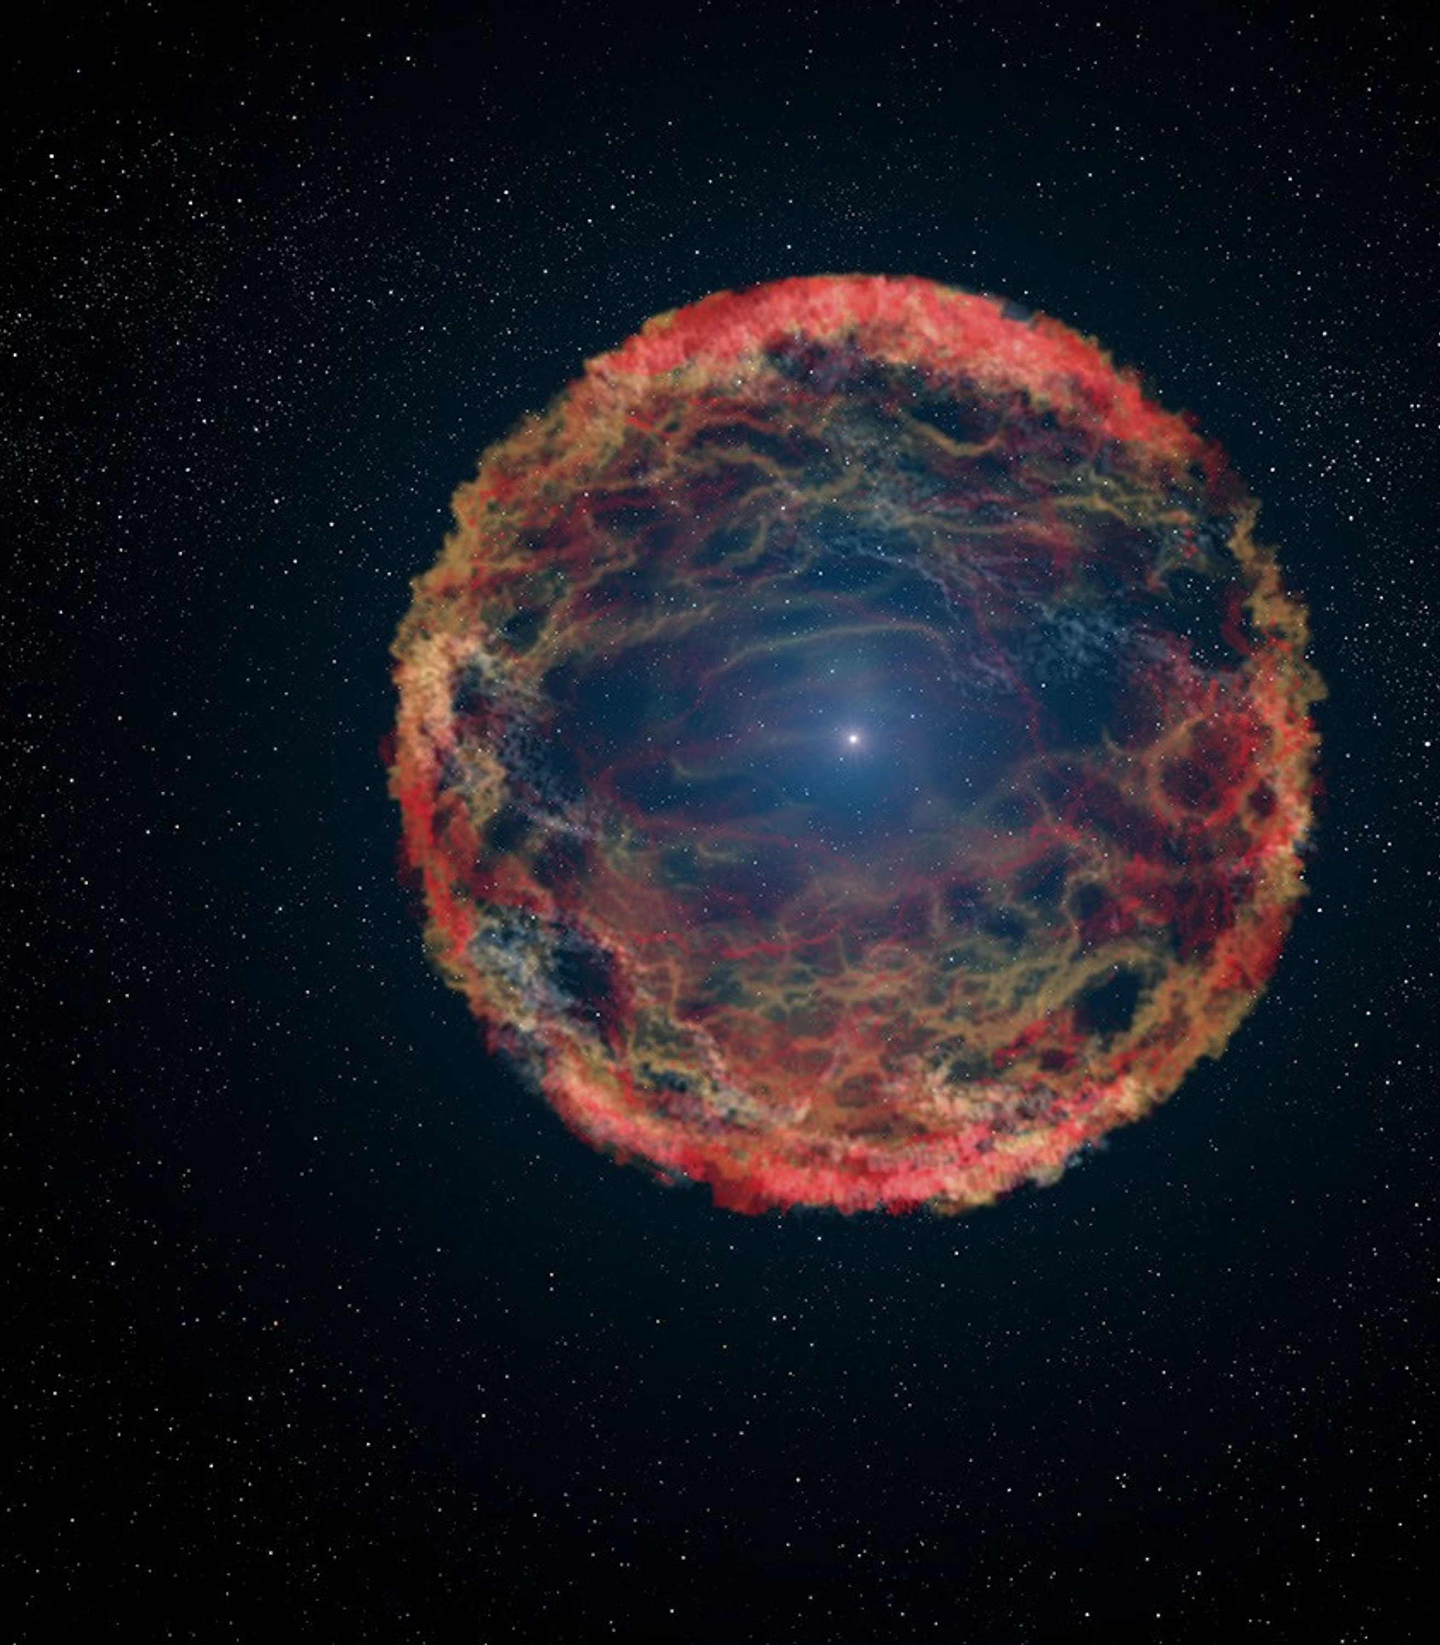
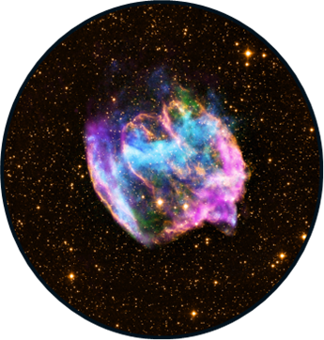
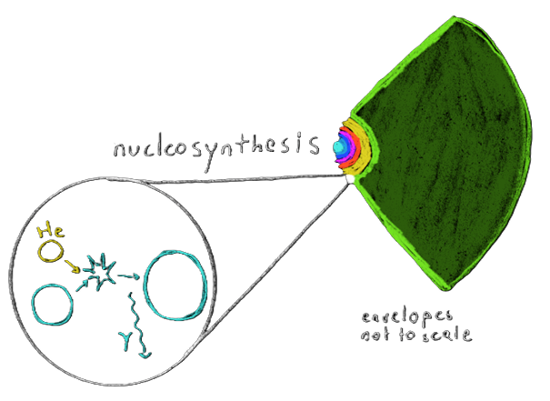
Background - Supernovae
Explosion of massive progenitor star
CCSN: Core collapses,
explosion triggers nucleosynthesis,
scatters elements
Images: NASA/CXC/MIT/L.Lopez et al/Palomar/NSF/NRAO/VLA.
NASA/ESA/G.Bacon (STScI).
Notes:
A star’s core can only fuse up to Fe; further fusion requires energy rather than producing it.
During a CCSN, which is >10 Msun, explosion energy outwards triggers nucleosynthesis in the outer envelope of the star; lots of fusion occurs and heavier elements are created.

Slide 4
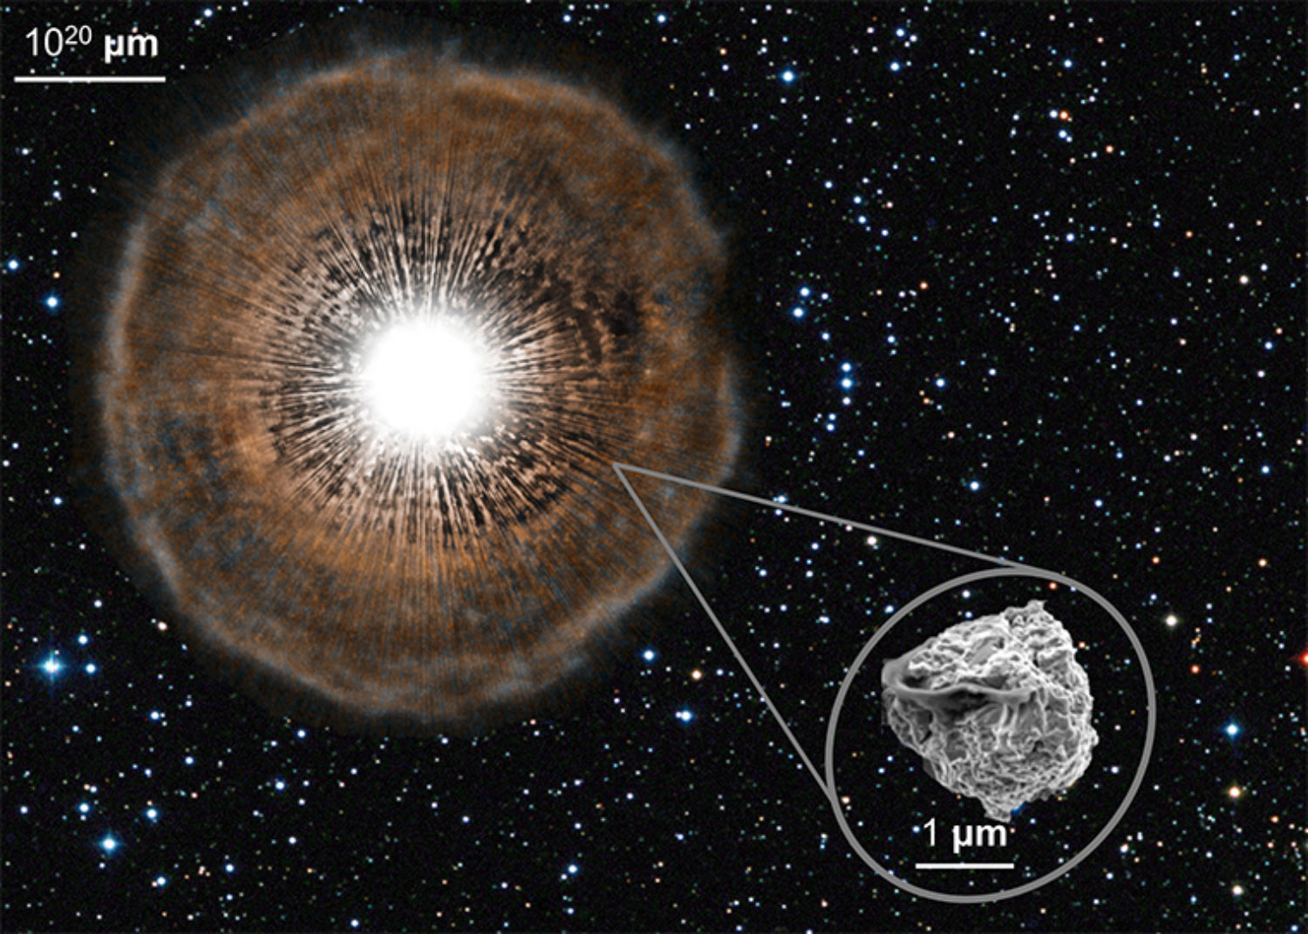
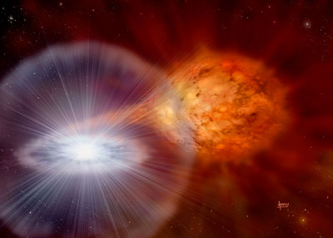
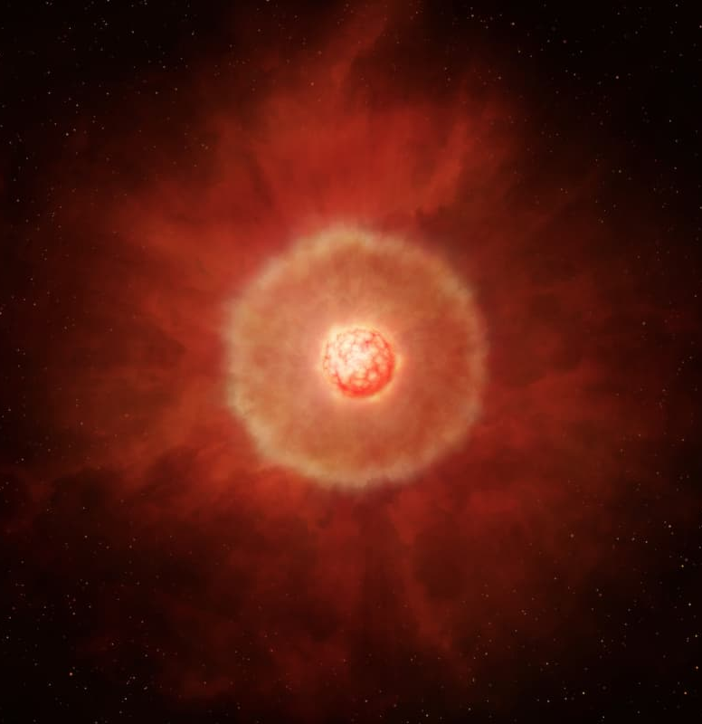
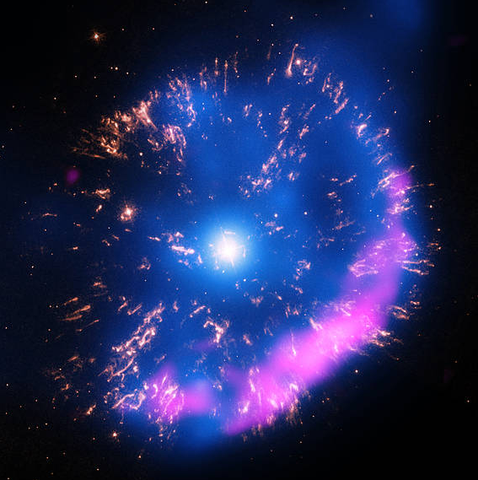
Background – Stardust sources
Type 1a SN
AGB Star
Nova
Different isotopic compositions
Images: NASA, N. Liu, A. Davis.
David A. Hardy
Miyata, Tachinabana, et al.
NASA Chandra X-ray Observatory.
Notes:
Grains outflowing from supernovae are called stardust, and we can find them in meteorites. Stardust can also come from other sources:
We can find them condensed in meteorites, micrometeorites, or sample returns. They are very tiny, at the micron scale. What they have in common is they all formed before our sun. We study their compositions to determine their source, and learn about how elements are dispersed in space.
Supernova: the explosion of a massive progenitor star (>10 M☉). Supernovae fuse light elements in their interiors, producing heavier elements and isotopic fractionation. In an energetic explosion, they scatter clumps of material into interstellar space.
Novae: gas accumulated by a white dwarf in a binary system is expelled in a high-energy event.
Asymptotic Giant Branch: low mass stars in late stages of their development. Outflows from AGB stars seed stardust.

Slide 5

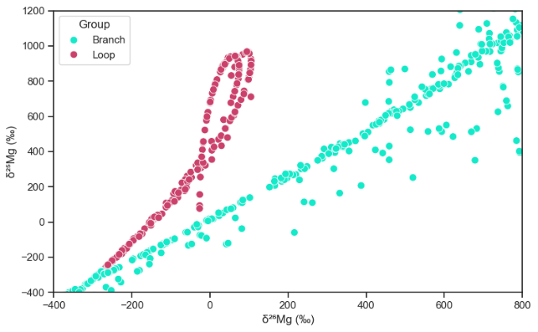

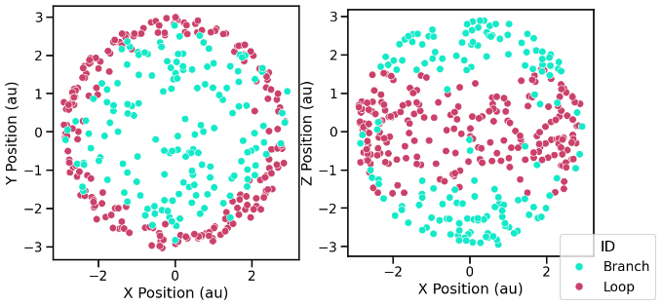





The Magnesium Isotope Space
Loop clumps positioned in a ring structure
radius of ~3 au
~43 hours after collapse
15 M⊙ progenitor, 3-D CCSN model, induced asymmetric explosion geometry

Slide 6
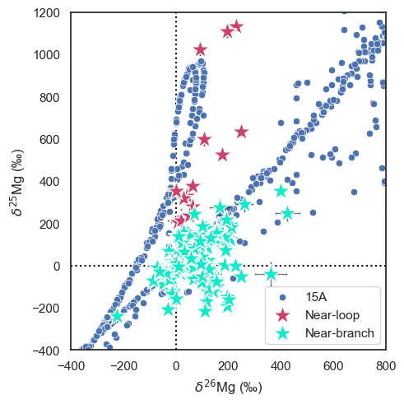
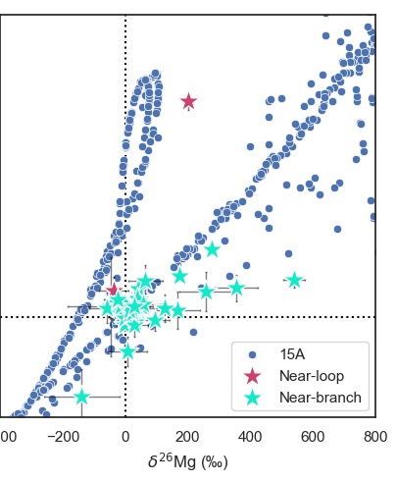
Silicate and Oxide Grain Classification
Meteorite stardust grain compositions from NanoSIMS
Grains categorized as near-loop or near-branch by comparing distances to trendlines
* Only silicate grains with complete Mg and Si system measurements shown here
Notes:
Using nano scale secondary ion mass spectrometry, isotopic compositions of grains have been measured and cataloged.
I categorized grains from literature and the Presolar Grain Database as either near-loop or near-branch by comparing their distances to trendlines of the loop and branch.

Slide 7
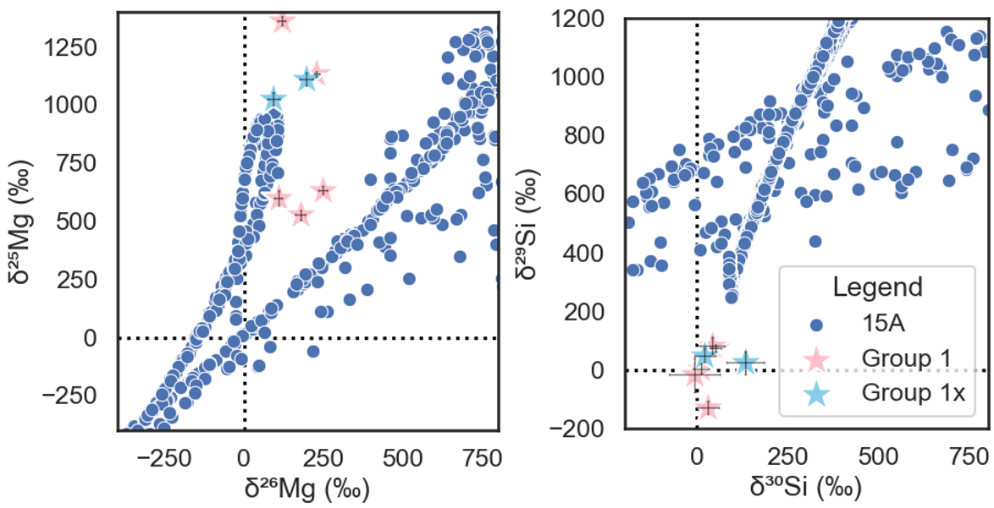




Comparison in Multiple Isotope Systems
Issue:
model isotope abundance cutoffs
Example: near-loop silicate grains
lead to not being able to plot all isotopes from the available model output.
Additionally, clumps may be excluded due to abundance cutoffs of other isotopes, perhaps explaining silicon mismatch.
Issue:
lack of measurements
of all isotopes required for bulk literature multi-system analysis.
…which is why getting more NanoSIMS measurements is helpful!!!
Magnesium
Silicon

Slide 8
Conclusion
If CCSN origin can be strongly attributed to stardust grains with anomalous magnesium isotope compositions…
…then the 3D model can be used to gain insights into the specific region of origin within the supernova outflow.

Slide 9


Thank you!
Do you have any questions?
elshepar@asu.edu
References
Hoppe P. et al. 2021, The Astrophysical Journal. 913 10
Jack Schulte et al. 2021, The Astrophysical Journal. 908 38
Lodders K. 2020, Solar Elemental Abundances, The Oxford Research Encyclopedia of Planetary Science.
Leitner J. & Hoppe P. 2019, Nature Astronomy 3. 725-729
Nittler L. et al. 2021, Meteoritics & Planetary Science 56.
Barosch J. et al. 2022, Geochimica et Cosmochimica Acta 335.
Nguyen A. et al. (2016) The Astrophysical Journal 818 51.
Acknowledgements
Mentor: Dr. Maitrayee Bose, ASU SESE
3D Supernova models: Dr. Patrick Young, ASU SESE
Center for Isotope Analysis, ASU
Slides: This presentation template was created by Slidesgo and includes icons by Flaticon
Supported in part through the Arizona NASA Space Grant Consortium, Cooperative Agreement 80NSSC20M0041.

